Slide 1
HANGYO
Designer vs Automated

Slide 2
Hangyo - at a glance
50 boards: designer JPEG (Mail folder) vs automated JPG (app output)
21/50
16/50
9/50
4/50
Very close
Close
Different
Wrong proportions
pixel similarity 95 % or more
88-95 % similar
under 88 % similar - layout or text differs
aspect ratio differs from the designer's by more than 5 %
How it is measured
Each automated JPG is paired with the designer JPEG of the same S.No, size and shop (the designer's '(1)' side matches the automated file without a suffix). Similarity = 1 - mean grey-level difference of both pictures at the same reduced size (average 0.91). It rates the whole picture, so a different shop name or a small shift barely moves it - look at the slides.
Proportions are compared from the pixel size of each picture.

Slide 3


S.No 1
Asian Juice bar
16 X 3 Feet - Frontlit
DIFFERENT (88 %)
DESIGNER
AUTOMATED

Slide 4


S.No 2
Sri Sai cafe (1)
3 X 6 Feet - Double Side GSB
VERY CLOSE (97 %)
DESIGNER
AUTOMATED

Slide 5
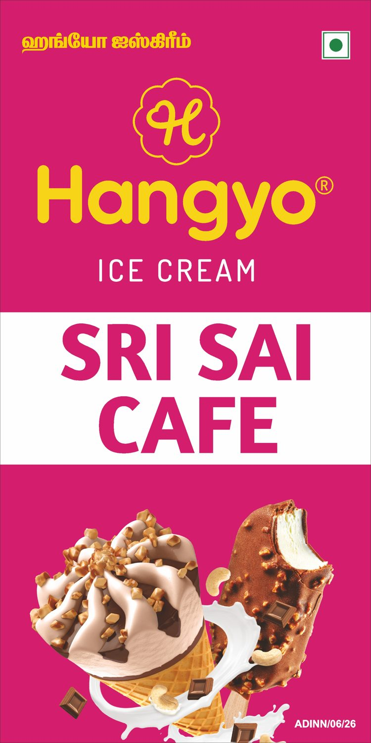
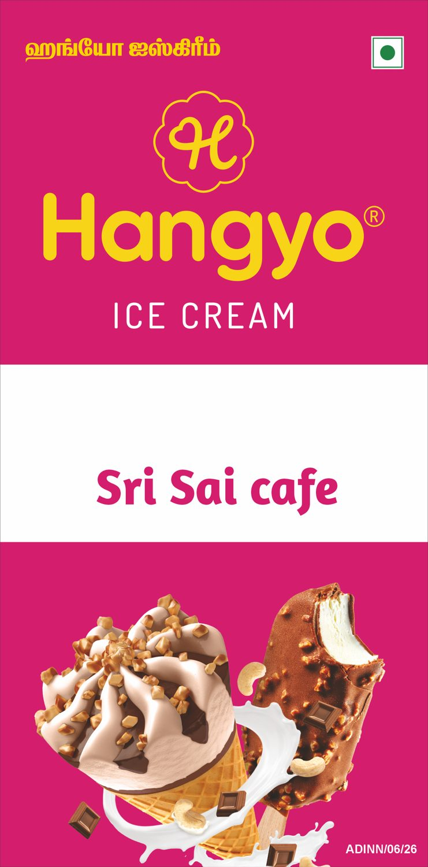
S.No 2
Sri Sai cafe (2)
3 X 6 Feet - Double Side GSB
VERY CLOSE (97 %)
DESIGNER
AUTOMATED

Slide 6

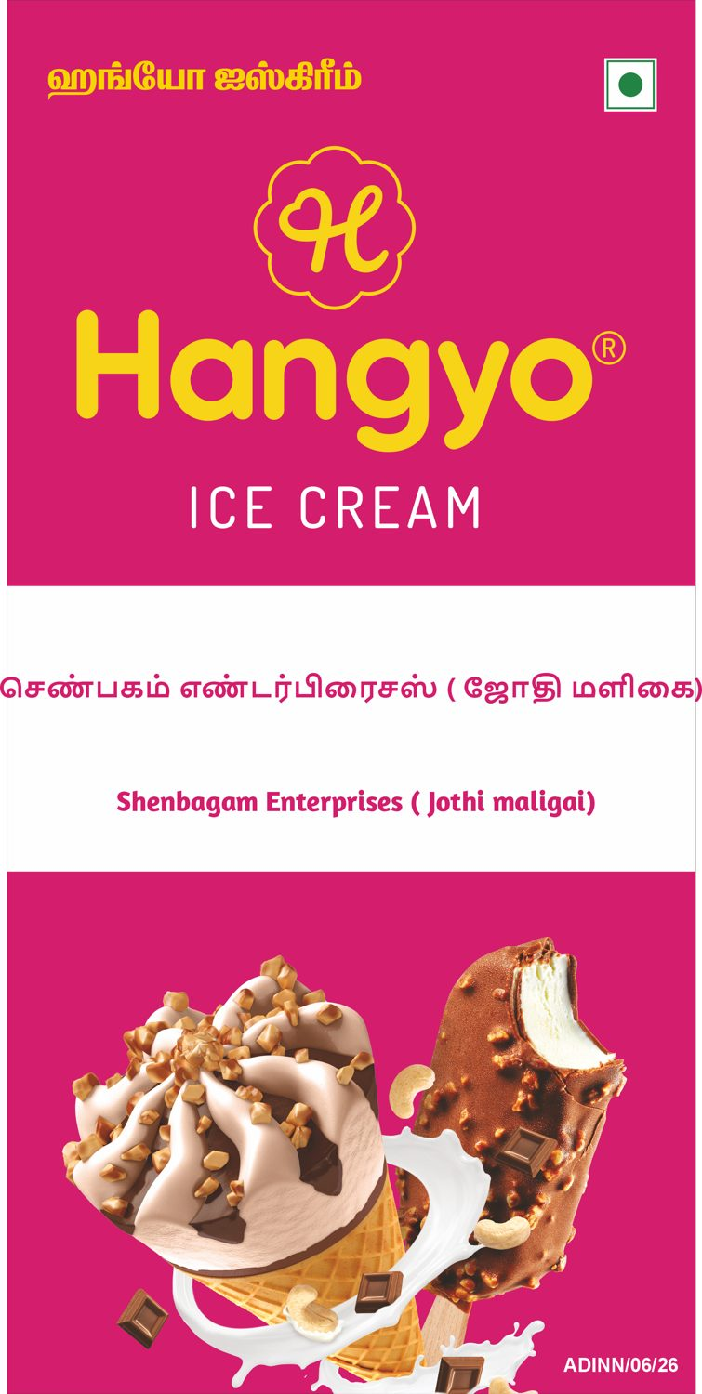
S.No 3
Shenbagam Enterprises ( Jothi maligai)
4 X 8 Feet - Nonlit
VERY CLOSE (95 %)
DESIGNER
AUTOMATED

Slide 7


S.No 4
Lakshmi Store
10 X 3 Feet - Nonlit
CLOSE (91 %)
DESIGNER
AUTOMATED

Slide 8
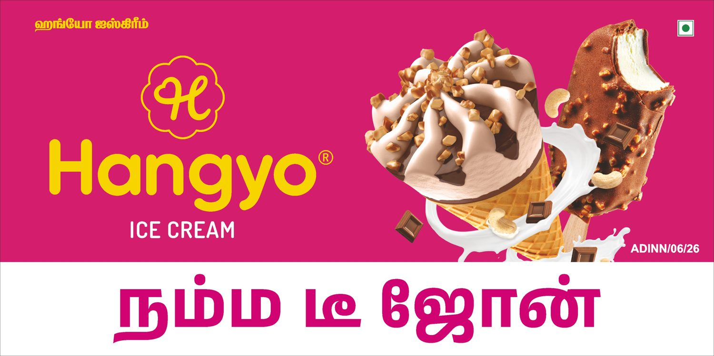

S.No 5
Namma T Zone (1)
6 X 3 Feet - Double Side GSB
VERY CLOSE (96 %)
DESIGNER
AUTOMATED

Slide 9
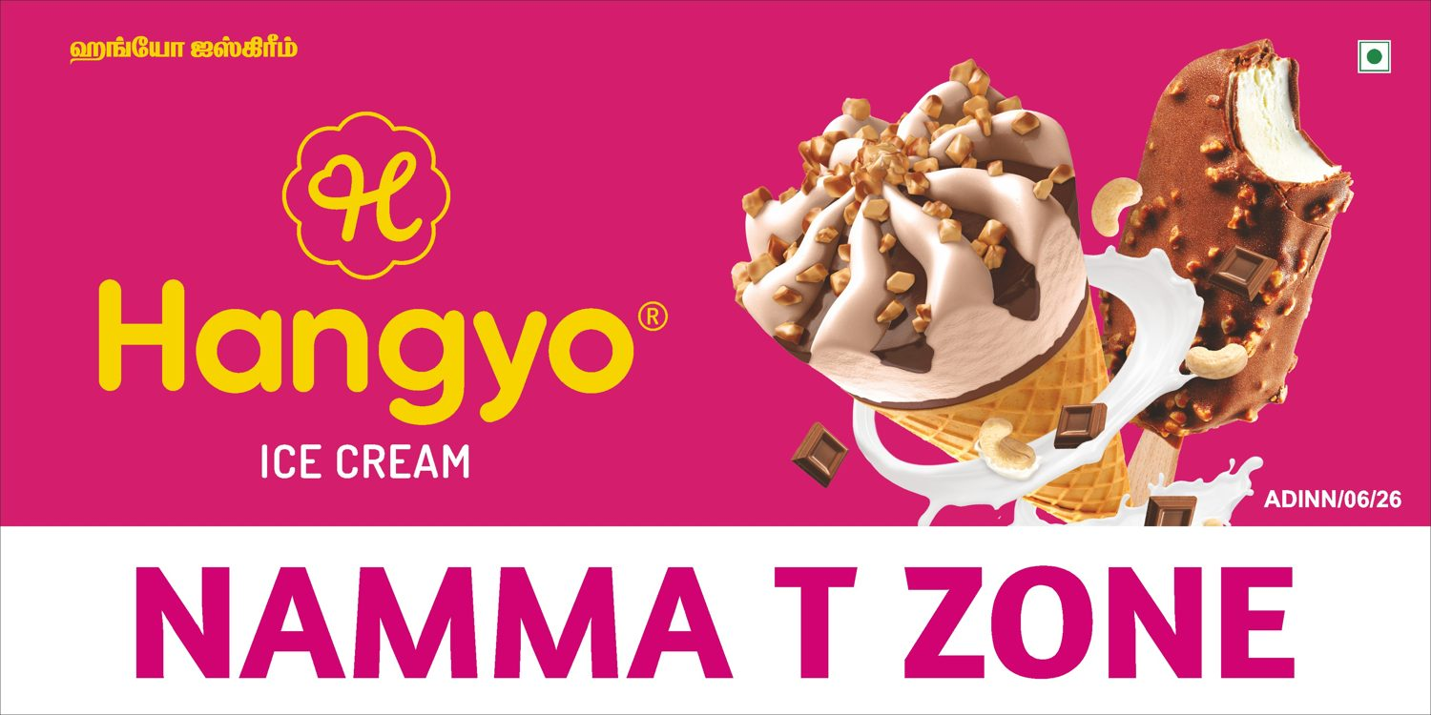
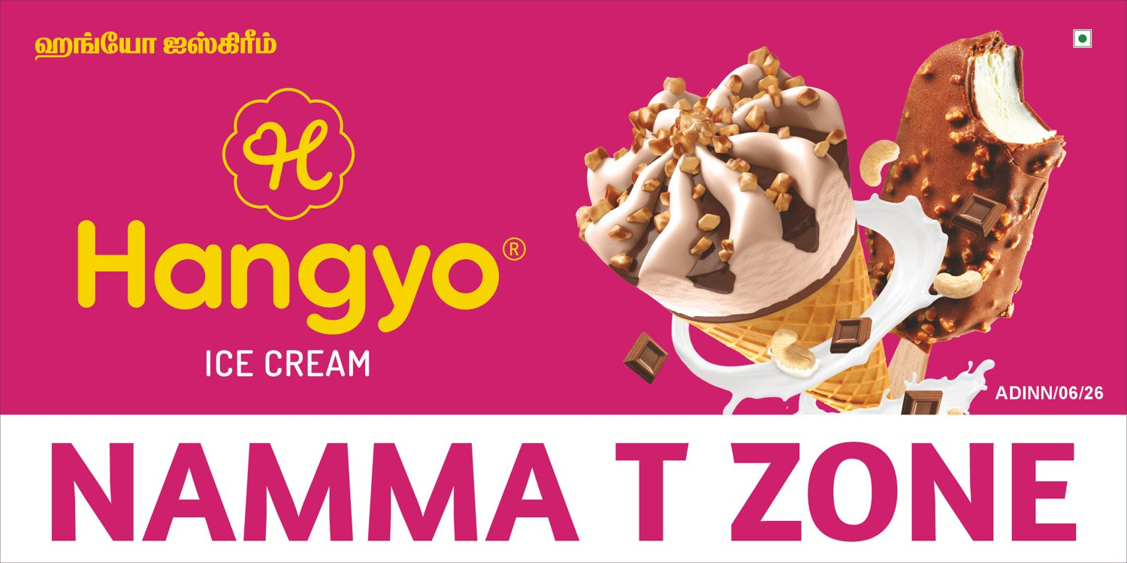
S.No 5
Namma T Zone (2)
6 X 3 Feet - Double Side GSB
CLOSE (95 %)
DESIGNER
AUTOMATED

Slide 10


S.No 6
Eriyur Bekary (1)
3 X 6 Feet - Double Side GSB
VERY CLOSE (97 %)
DESIGNER
AUTOMATED

Slide 11
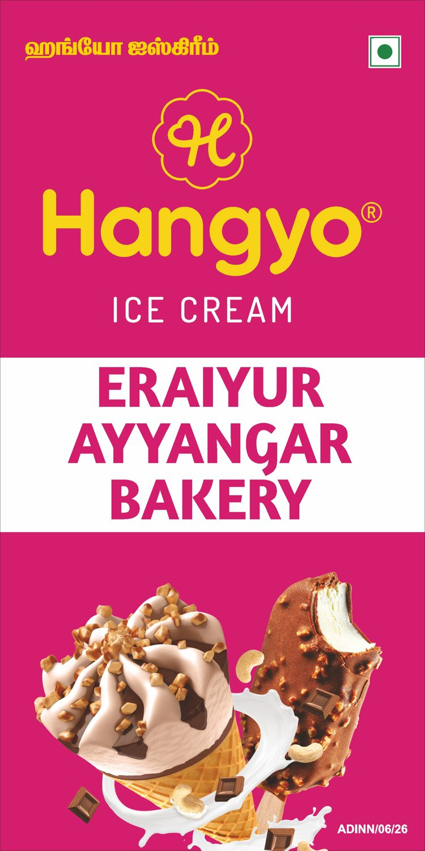
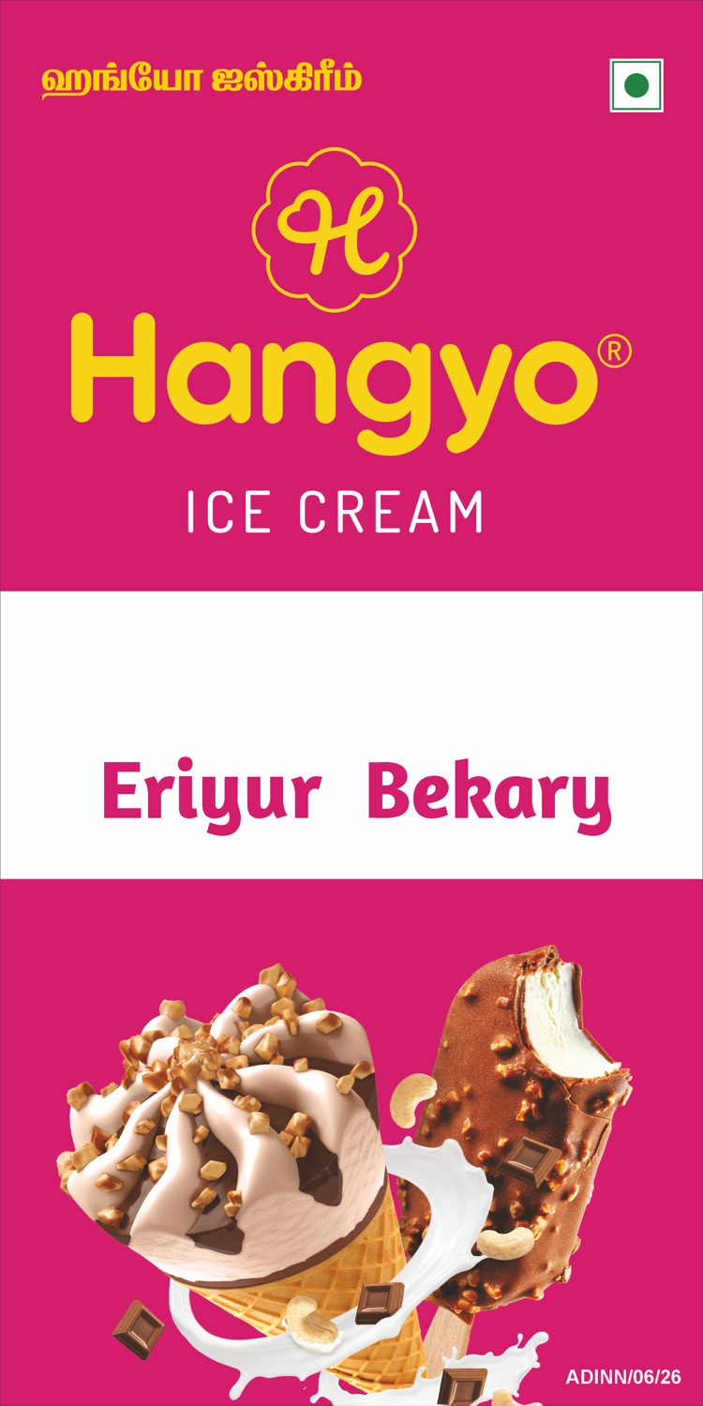
S.No 6
Eriyur Bekary (2)
3 X 6 Feet - Double Side GSB
VERY CLOSE (97 %)
DESIGNER
AUTOMATED

Slide 12


S.No 7
New Chennai bakery (1)
4 X 7 Feet - Double Side GSB
CLOSE (92 %)
DESIGNER
AUTOMATED

Slide 13
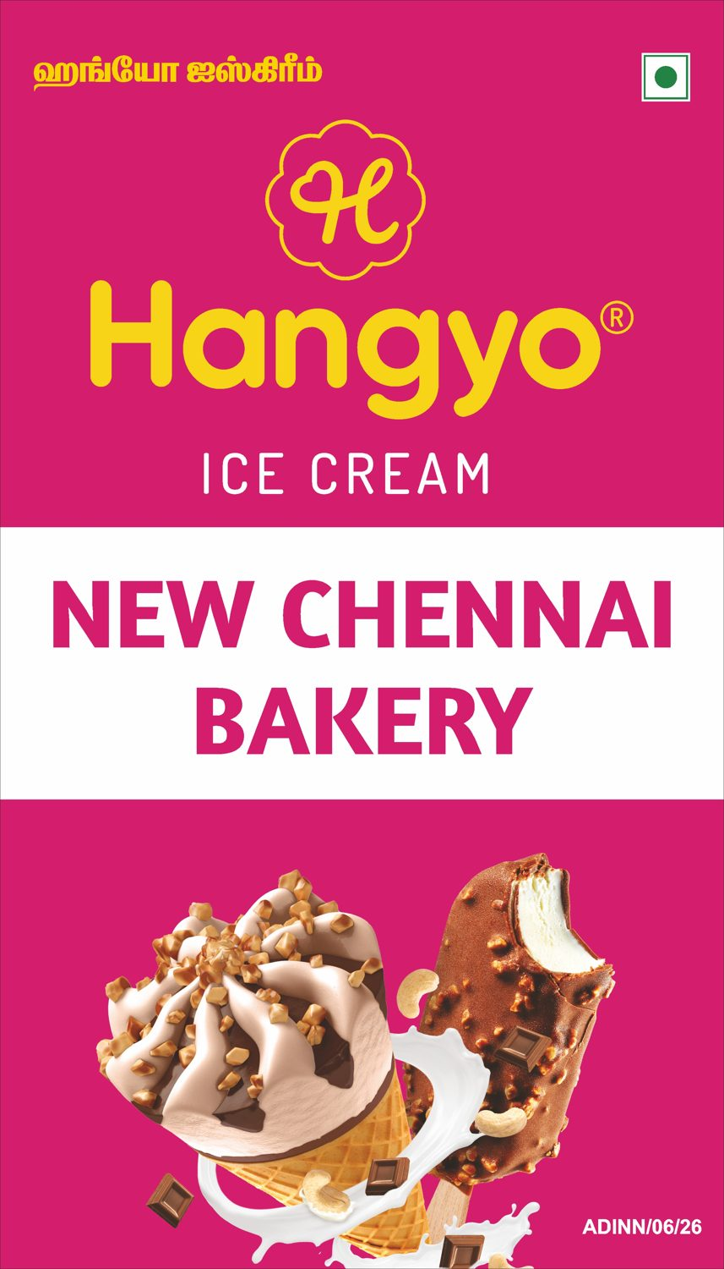

S.No 7
New Chennai bakery (2)
4 X 7 Feet - Double Side GSB
CLOSE (92 %)
DESIGNER
AUTOMATED

Slide 14

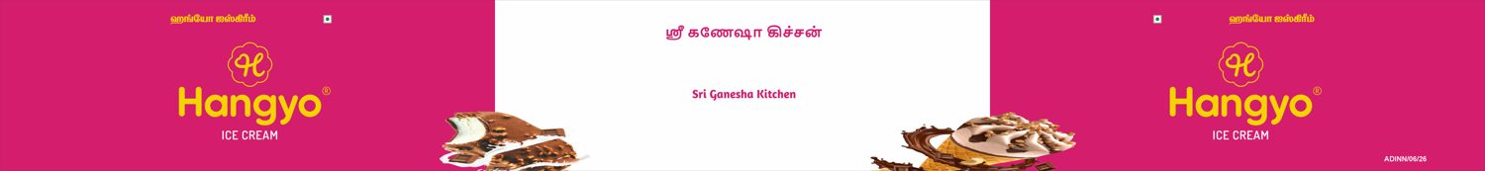
S.No 8
Sri Ganesha Kitchen
26 X 3 Feet - Frontlit
DIFFERENT (87 %)
DESIGNER
AUTOMATED

Slide 15


S.No 8
Sri Ganesha Kitchen (1)
8 X 4 Feet - Double Side GSB
VERY CLOSE (96 %)
DESIGNER
AUTOMATED

Slide 16
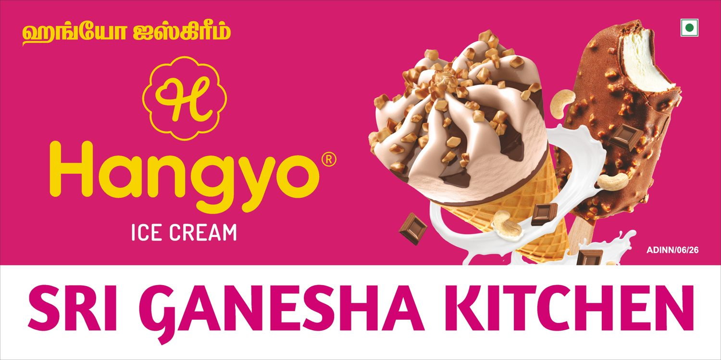
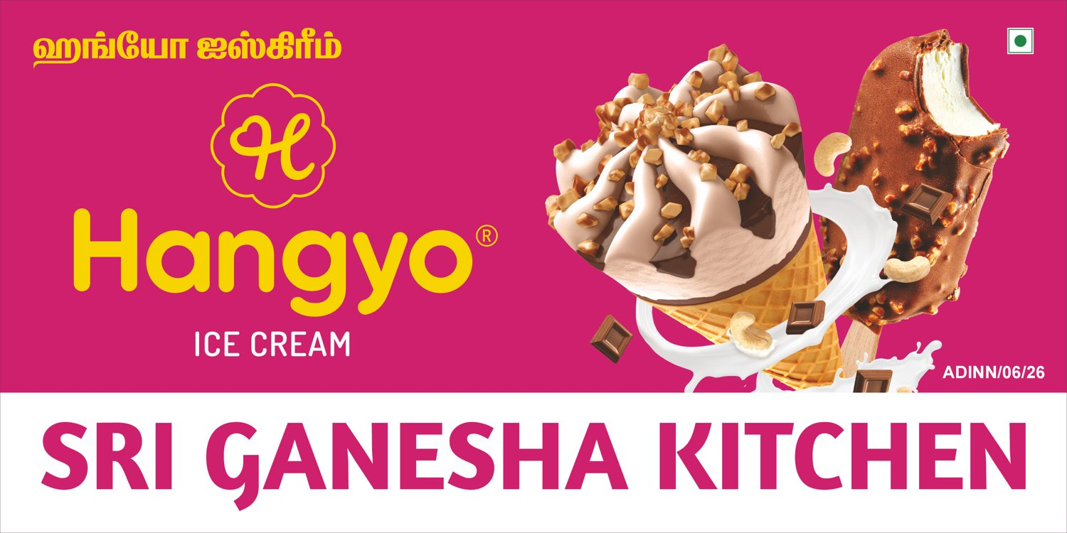
S.No 8
Sri Ganesha Kitchen (2)
8 X 4 Feet - Double Side GSB
VERY CLOSE (99 %)
DESIGNER
AUTOMATED

Slide 17

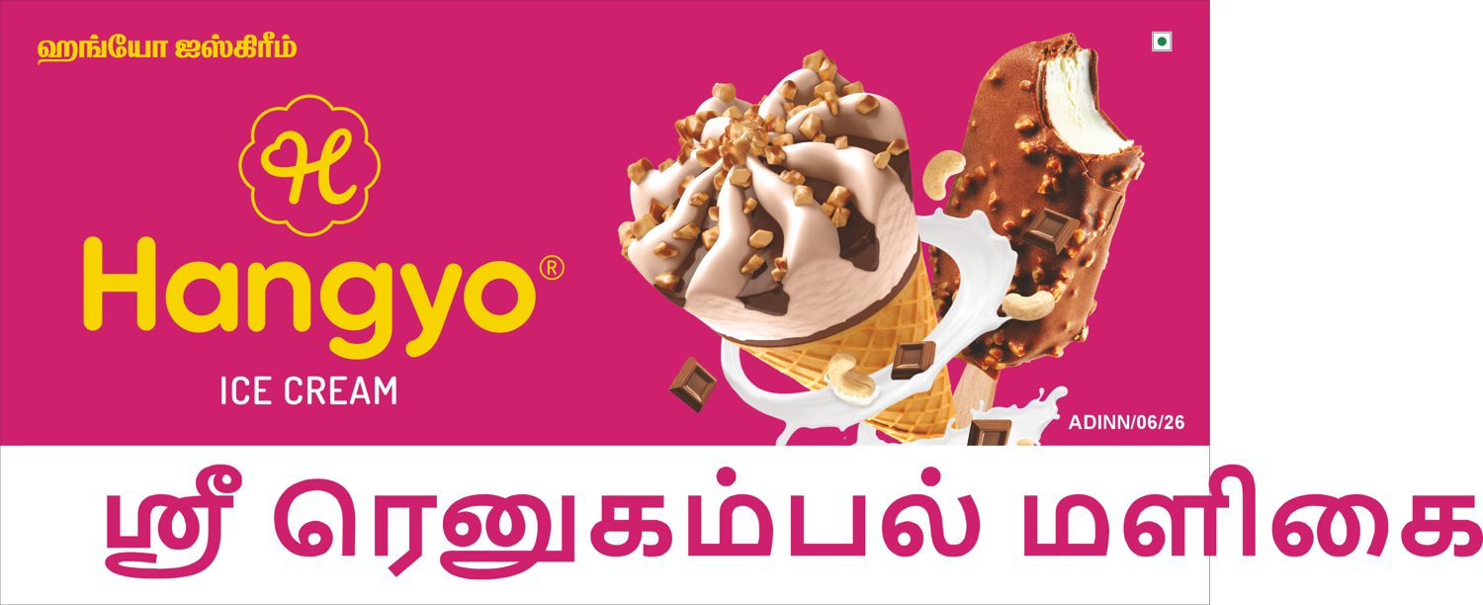
S.No 9
Sri renugambal maligai (1)
6 X 3 Feet - Double SIde GSB
WRONG SIZE (80 %)
DESIGNER
AUTOMATED

Slide 18
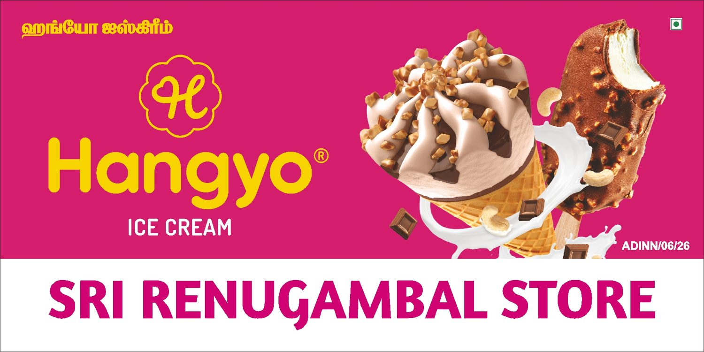

S.No 9
Sri renugambal maligai (2)
6 X 3 Feet - Double SIde GSB
VERY CLOSE (96 %)
DESIGNER
AUTOMATED

Slide 19


S.No 10
Jeeva hotel
20 X 4 Feet - Frontlit
DIFFERENT (87 %)
DESIGNER
AUTOMATED

Slide 20


S.No 10
Jeeva hotel (1)
6 X 3 Feet - Double Side GSB
VERY CLOSE (96 %)
DESIGNER
AUTOMATED

Slide 21
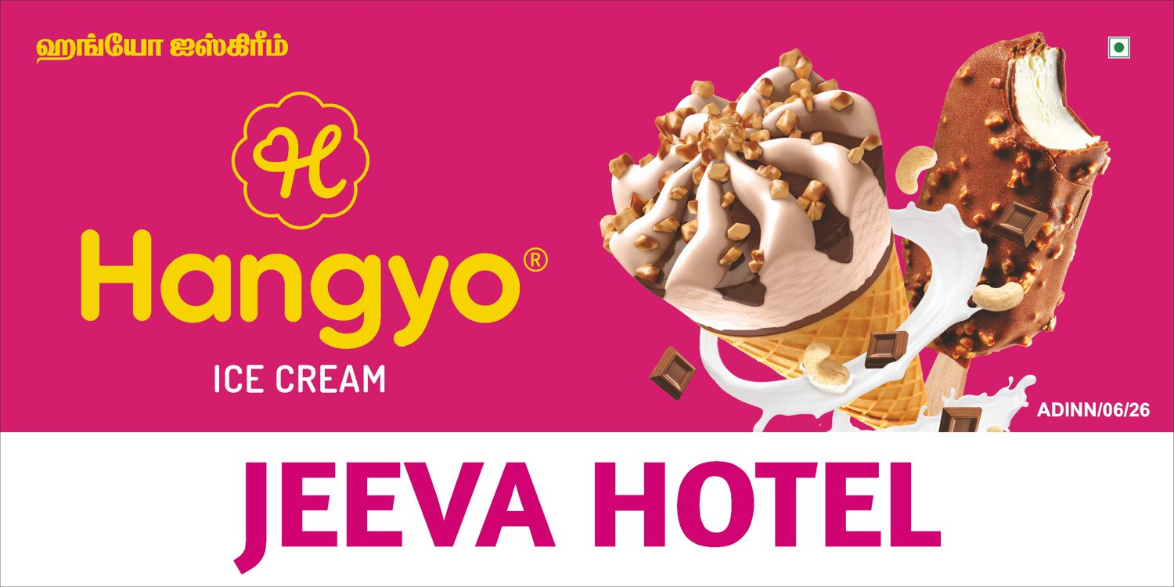
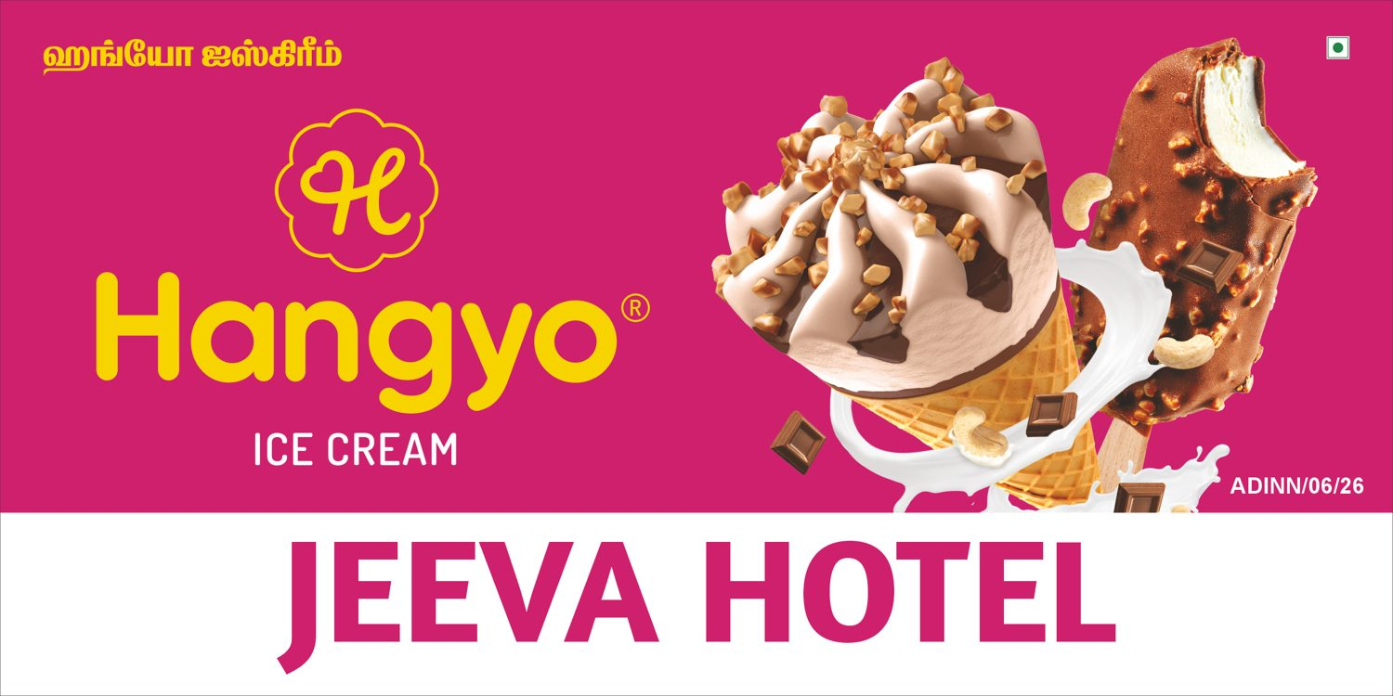
S.No 10
Jeeva hotel (2)
6 X 3 Feet - Double Side GSB
VERY CLOSE (99 %)
DESIGNER
AUTOMATED

Slide 22

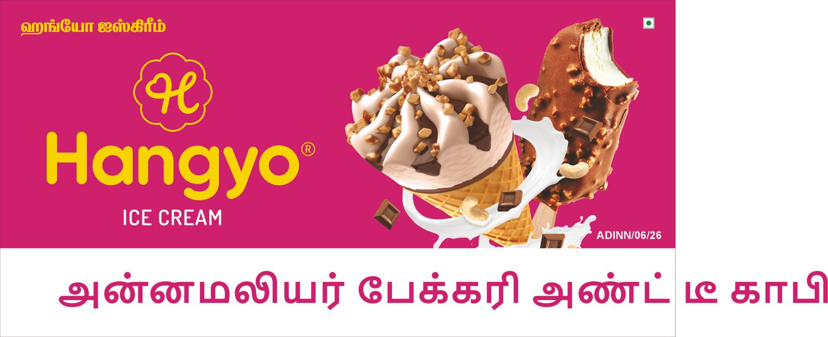
S.No 11
Annamaliyar bakery And tea coffee (1)
6 X 3 Feet - Double Side GSB
WRONG SIZE (81 %)
DESIGNER
AUTOMATED

Slide 23
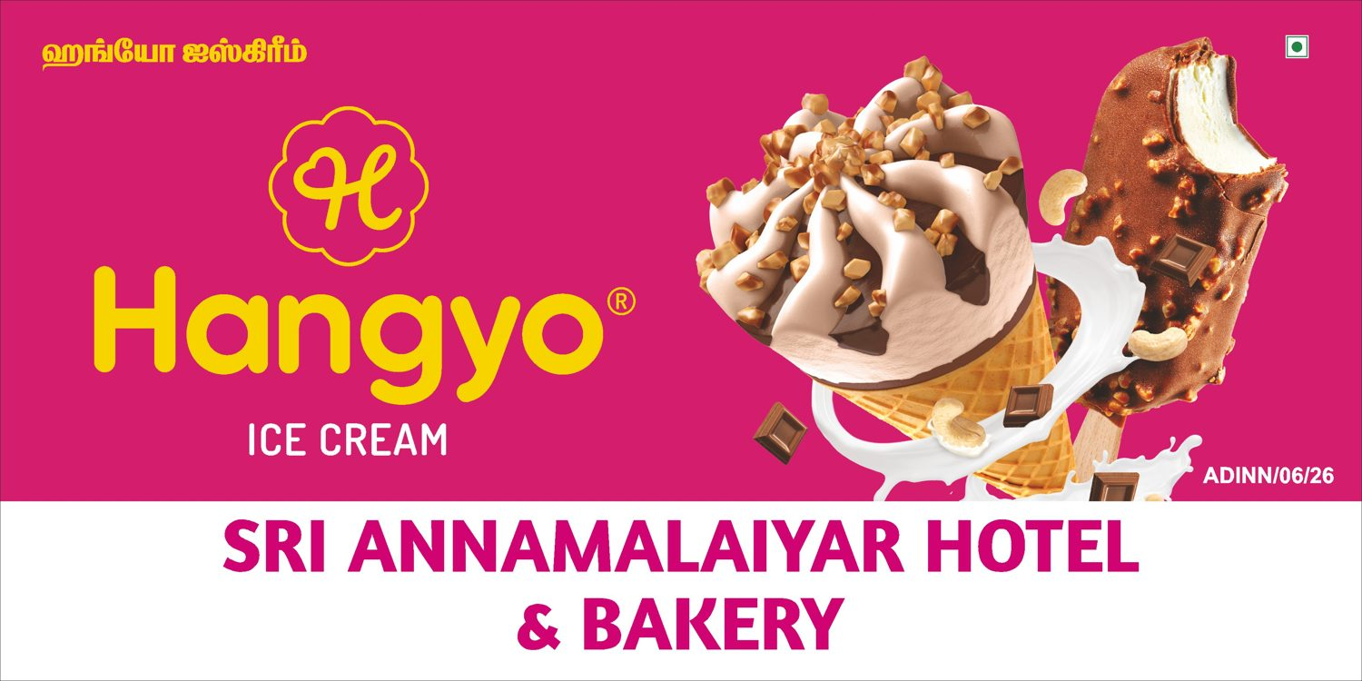
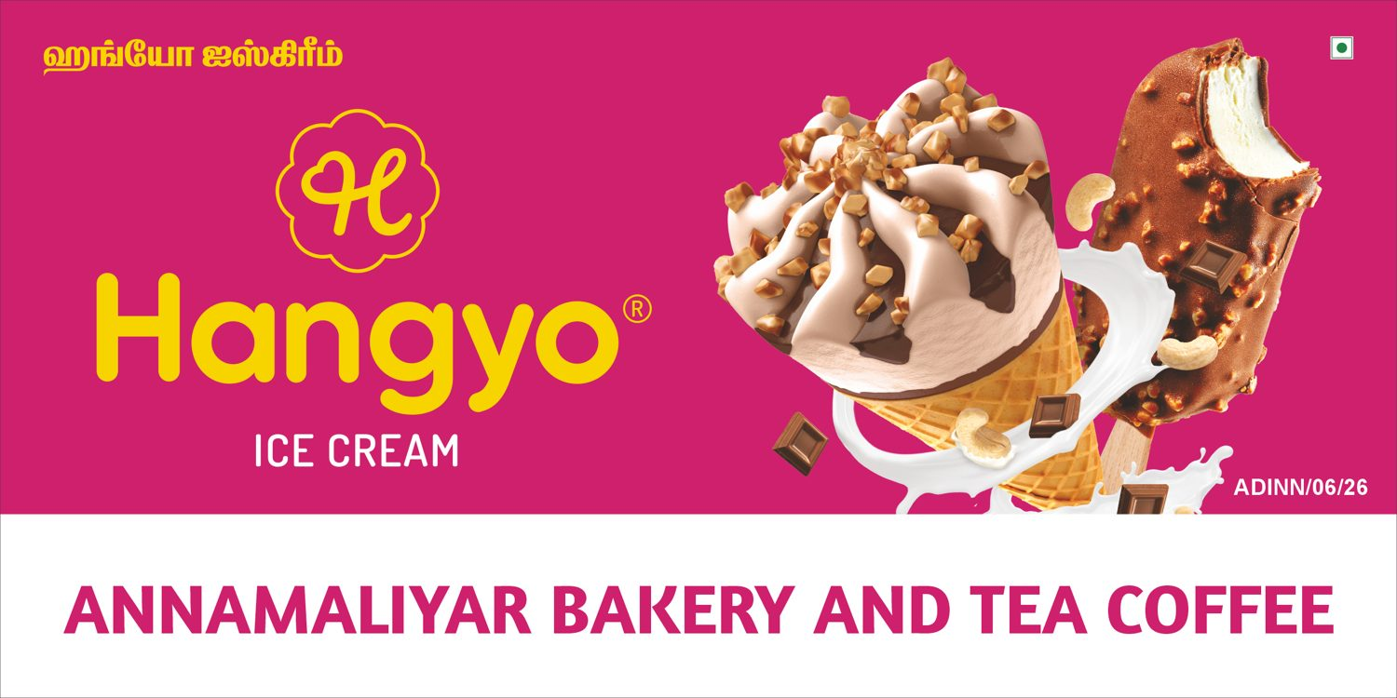
S.No 11
Annamaliyar bakery And tea coffee (2)
6 X 3 Feet - Double Side GSB
VERY CLOSE (95 %)
DESIGNER
AUTOMATED

Slide 24


S.No 12
Saravanan maligai store (1)
6 X 3 Feet - Double Side GSB
WRONG SIZE (81 %)
DESIGNER
AUTOMATED

Slide 25


S.No 12
Saravanan maligai store (2)
6 X 3 Feet - Double Side GSB
VERY CLOSE (96 %)
DESIGNER
AUTOMATED

Slide 26

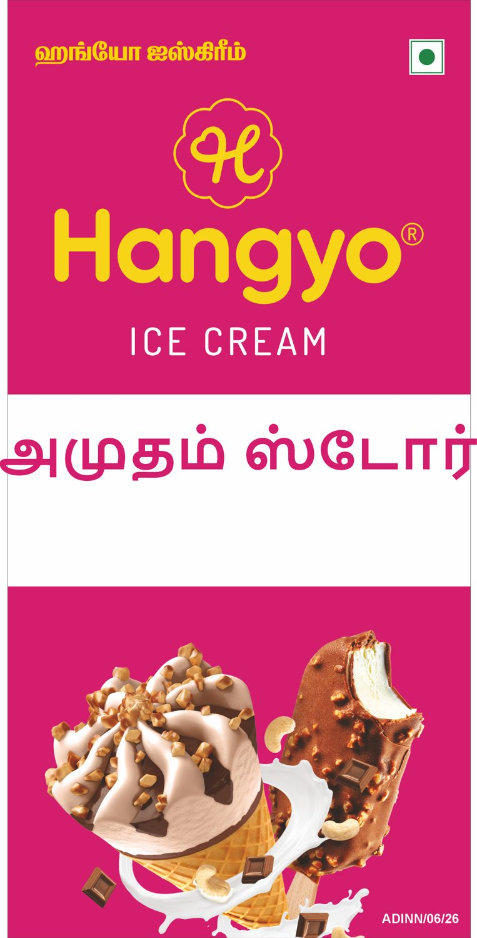
S.No 13
Amutham Store (1)
3 X 6 Feet - Double Side GSB
CLOSE (93 %)
DESIGNER
AUTOMATED

Slide 27
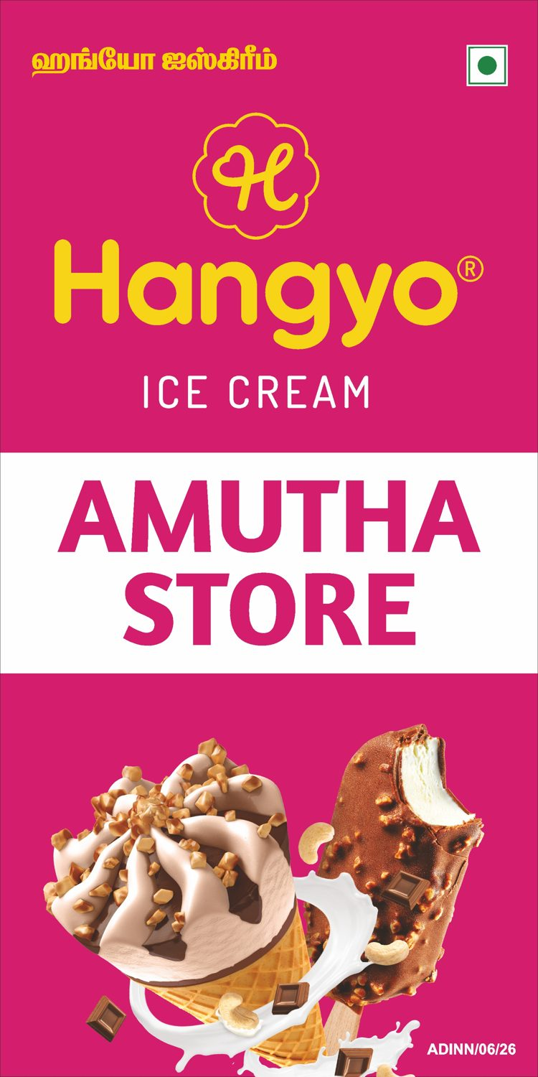

S.No 13
Amutham Store (2)
3 X 6 Feet - Double Side GSB
VERY CLOSE (97 %)
DESIGNER
AUTOMATED

Slide 28

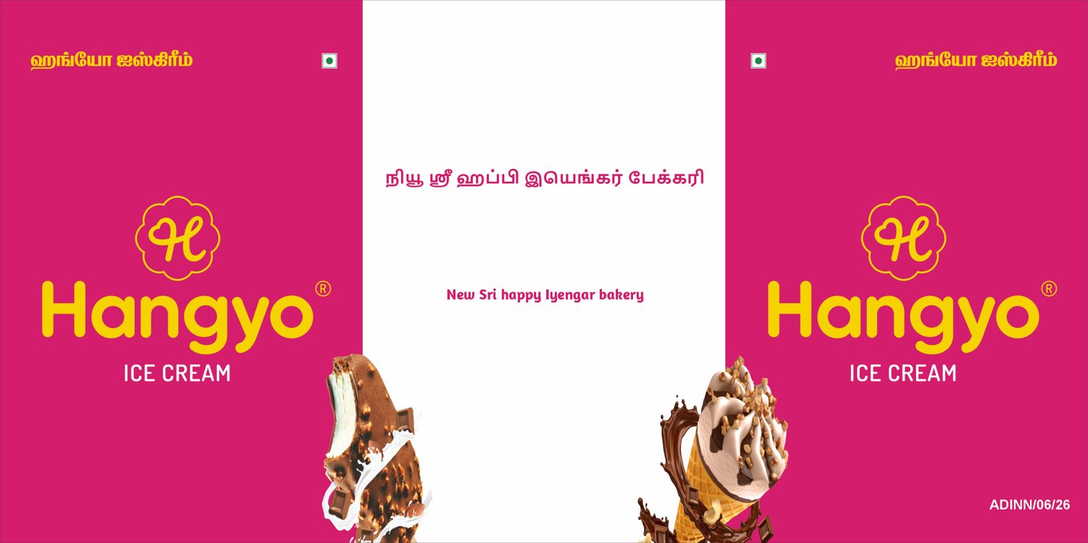
S.No 14
New Sri happy Iyengar bakery
8 X 4 Feet - GSB
DIFFERENT (70 %)
DESIGNER
AUTOMATED

Slide 29

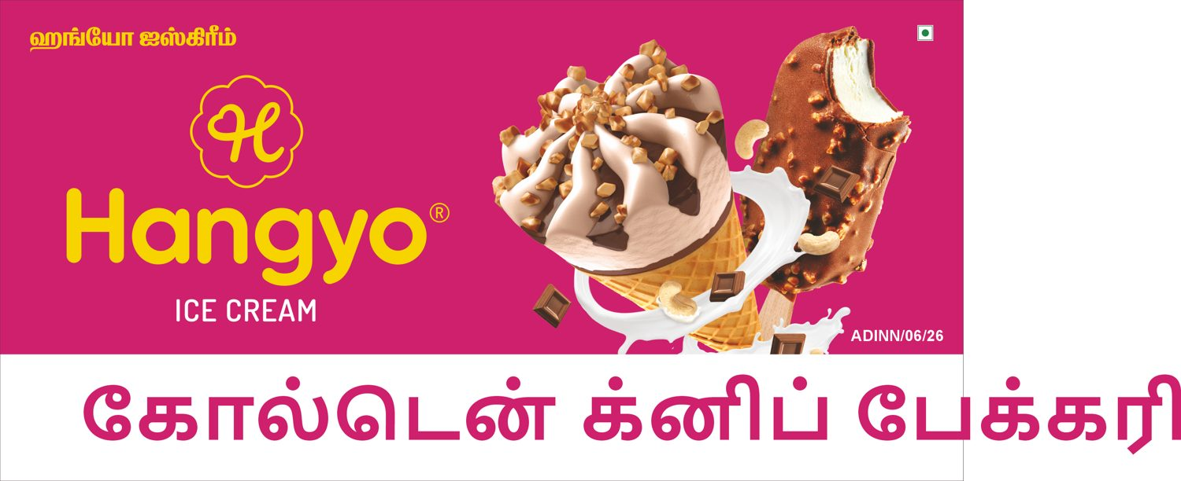
S.No 15
Golden Knife Bakery (1)
6 X 3 Feet - Double Side GSB
WRONG SIZE (81 %)
DESIGNER
AUTOMATED

Slide 30


S.No 15
Golden Knife Bakery (2)
6 X 3 Feet - Double Side GSB
VERY CLOSE (99 %)
DESIGNER
AUTOMATED

Slide 31


S.No 16
Shanvi fancy store (1)
3 X 5 Feet - Double Side GSB
CLOSE (92 %)
DESIGNER
AUTOMATED

Slide 32
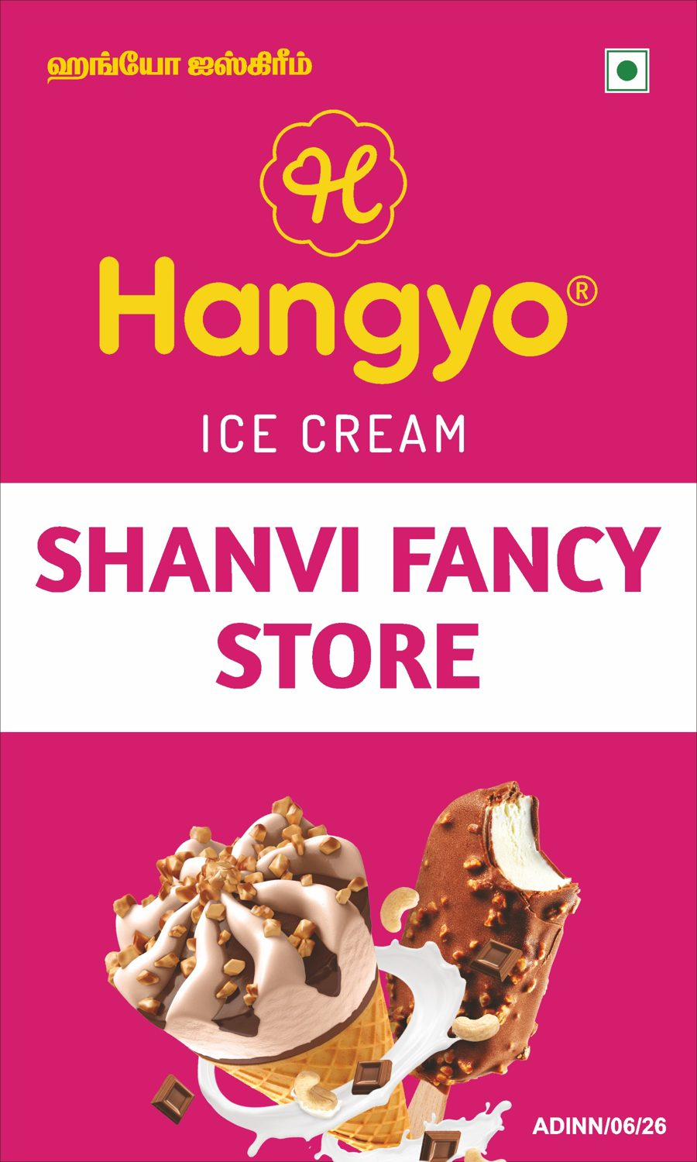
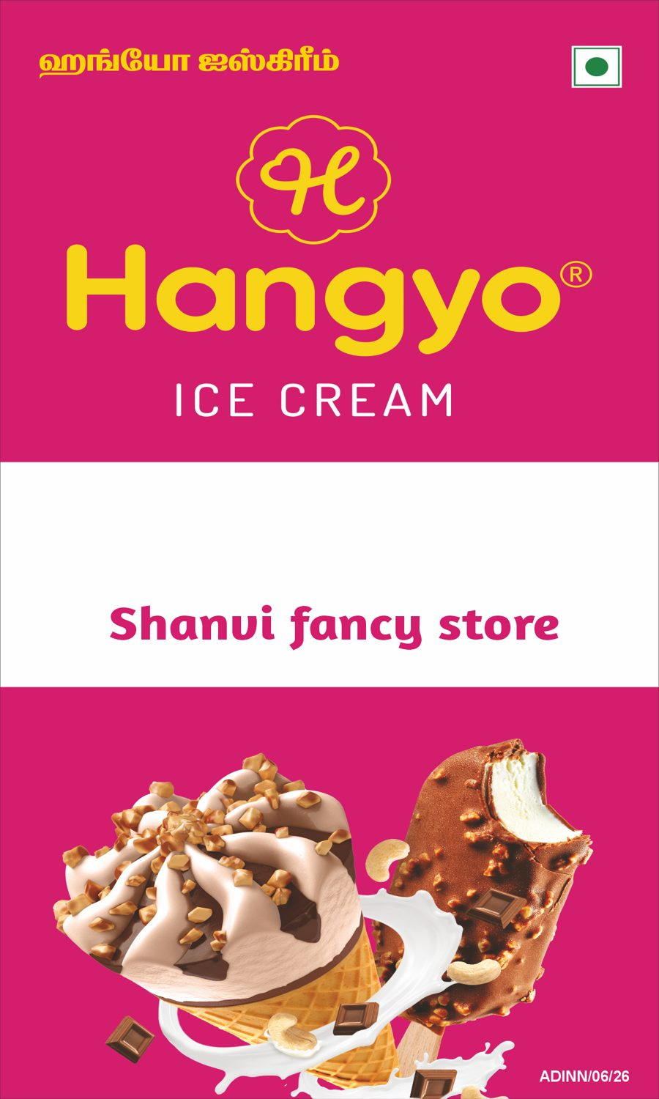
S.No 16
Shanvi fancy store (2)
3 X 5 Feet - Double Side GSB
CLOSE (91 %)
DESIGNER
AUTOMATED

Slide 33
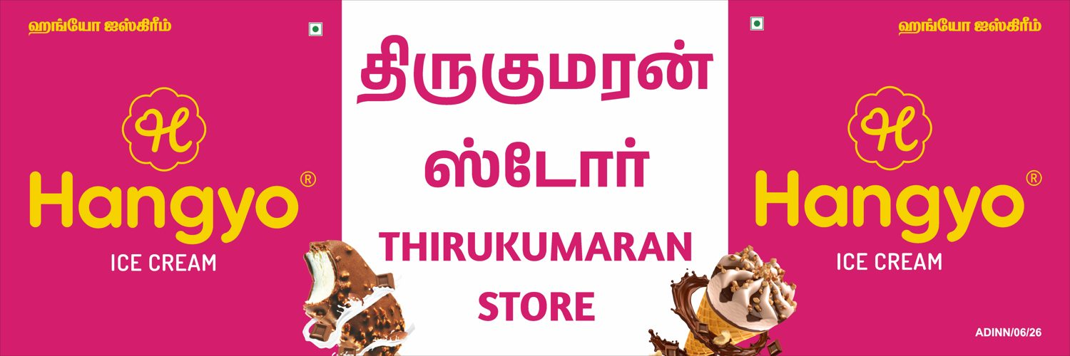

S.No 17
Thirukumaran store
12 X 4 Feet - Nonlit
CLOSE (90 %)
DESIGNER
AUTOMATED

Slide 34

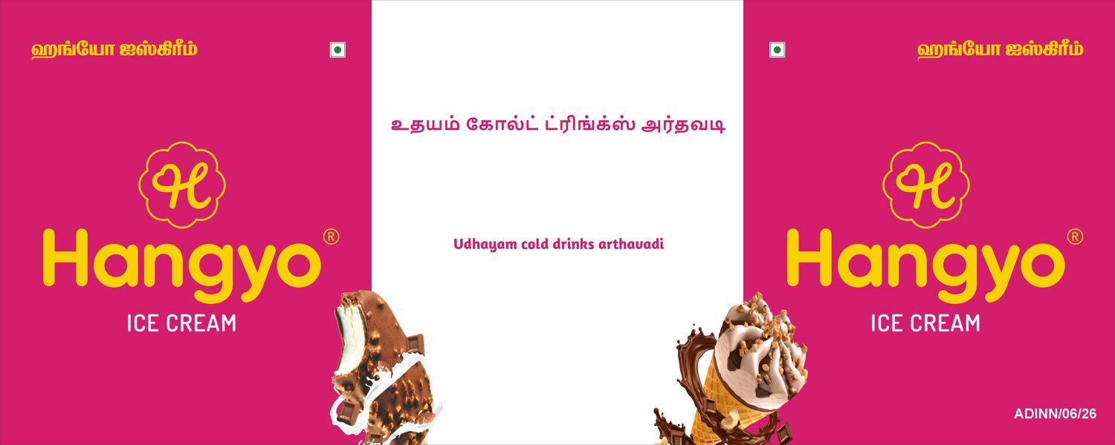
S.No 18
Udhayam cold drinks arthavadi
10 X 4 Feet - GSB
DIFFERENT (73 %)
DESIGNER
AUTOMATED

Slide 35


S.No 19
Sivani Maligai
10 X 3 Feet - GSB
CLOSE (92 %)
DESIGNER
AUTOMATED

Slide 36

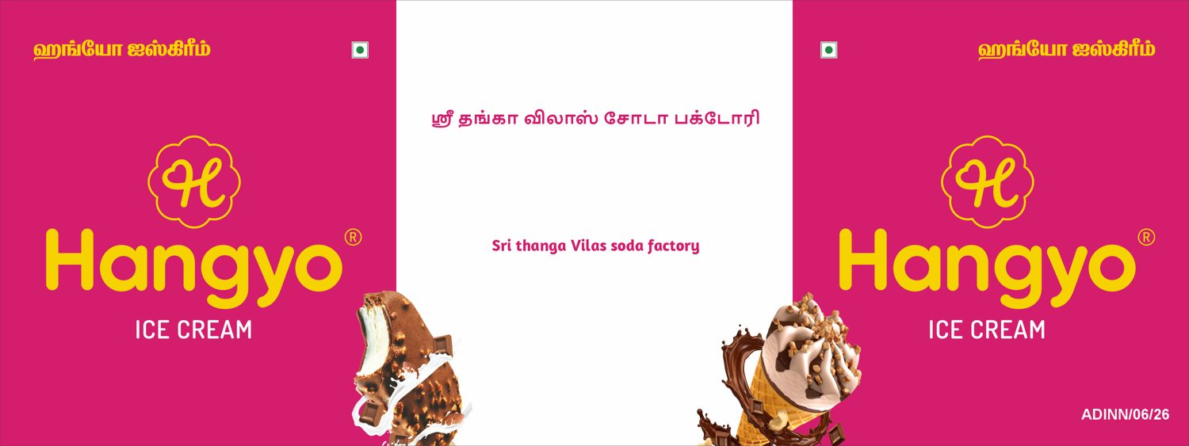
S.No 20
Sri thanga Vilas soda factory
8 X 3 Feet - GSB
DIFFERENT (73 %)
DESIGNER
AUTOMATED

Slide 37

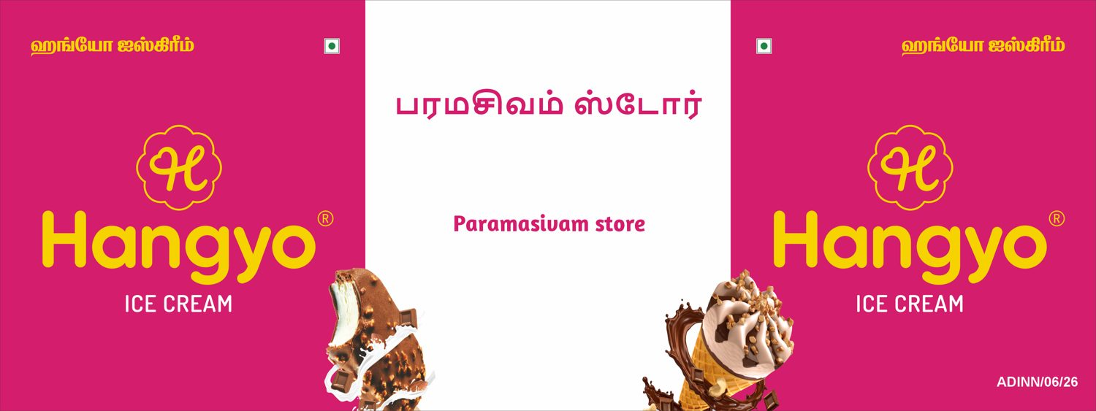
S.No 21
Paramasivam store
8 X 3 Feet - GSB
DIFFERENT (73 %)
DESIGNER
AUTOMATED

Slide 38


S.No 22
Bengaluru bakery
20 X 3 Feet - Frontlit
CLOSE (89 %)
DESIGNER
AUTOMATED

Slide 39


S.No 23
Guru tea stall
10 X 3 Feet - Frontlit
CLOSE (94 %)
DESIGNER
AUTOMATED

Slide 40


S.No 24
PERUMAL STORE
20 X 4 Feet - Frontlit
CLOSE (91 %)
DESIGNER
AUTOMATED

Slide 41


S.No 24
PERUMAL STORE (1)
6 X 3 Feet - Double Side GSB
VERY CLOSE (96 %)
DESIGNER
AUTOMATED

Slide 42


S.No 24
PERUMAL STORE (2)
6 X 3 Feet - Double Side GSB
VERY CLOSE (98 %)
DESIGNER
AUTOMATED

Slide 43


S.No 25
Karthikeyan store
10 X 3 Feet - GSB
CLOSE (95 %)
DESIGNER
AUTOMATED

Slide 44


S.No 25
Karthikeyan store
20 X 3 Feet - Frontlit
CLOSE (89 %)
DESIGNER
AUTOMATED

Slide 45


S.No 26
Om guru sweets & bakery
20 X 3 Feet - GSB
CLOSE (89 %)
DESIGNER
AUTOMATED

Slide 46
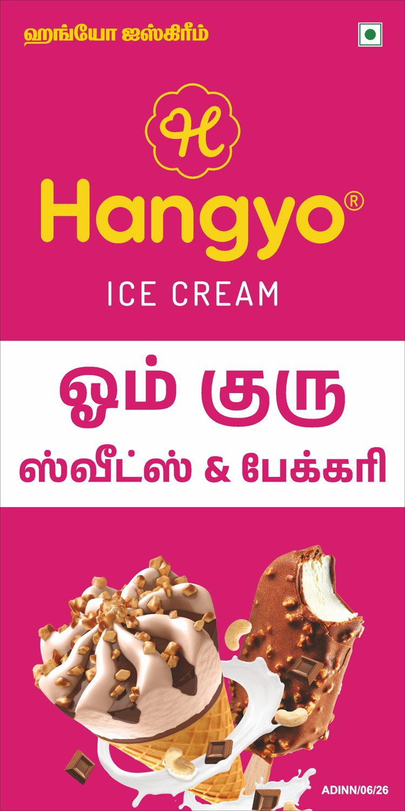

S.No 26
Om guru sweets & bakery (1)
3 X 6 Feet - Double Side GSB
VERY CLOSE (96 %)
DESIGNER
AUTOMATED

Slide 47
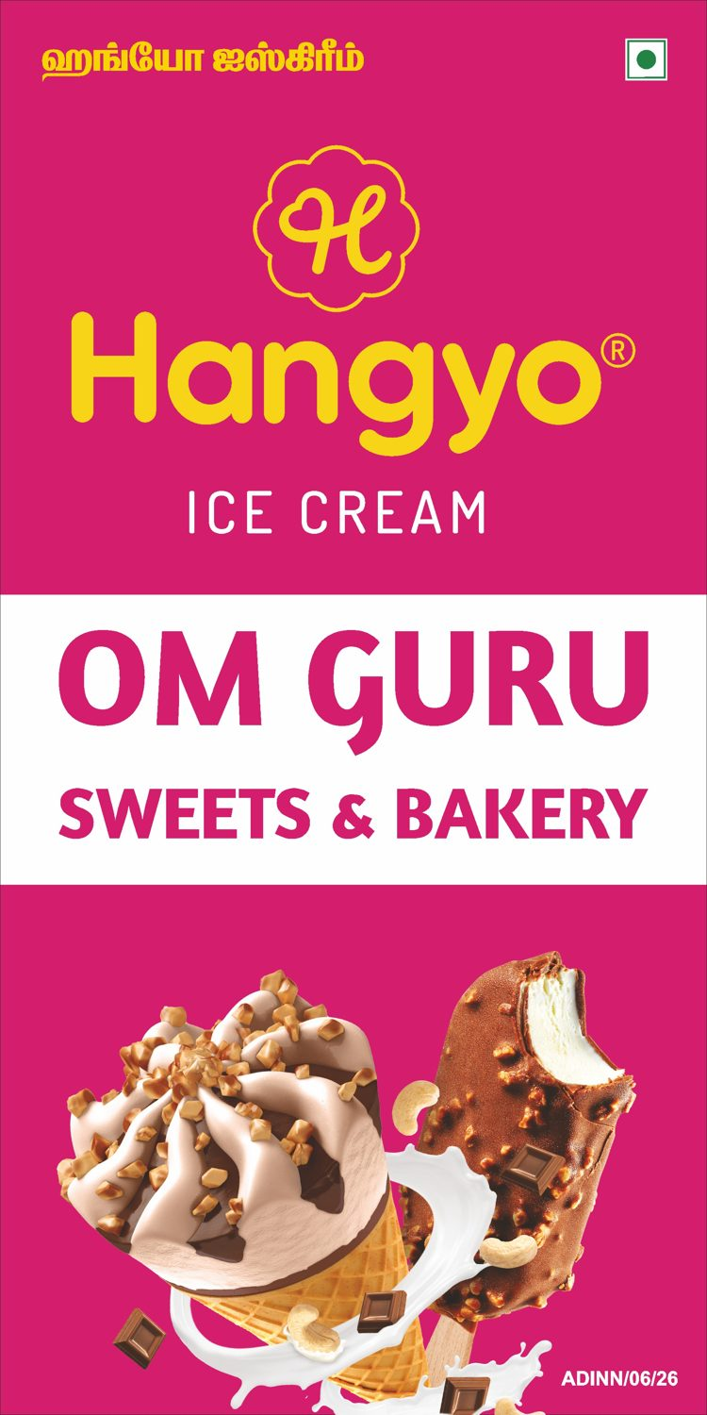

S.No 26
Om guru sweets & bakery (2)
3 X 6 Feet - Double Side GSB
VERY CLOSE (96 %)
DESIGNER
AUTOMATED

Slide 48


S.No 27
Jairam maligai
20 X 4 Feet - Nonlit
DIFFERENT (87 %)
DESIGNER
AUTOMATED

Slide 49


S.No 28
Sekar store
10 X 3 Feet - Nonlit
CLOSE (94 %)
DESIGNER
AUTOMATED

Slide 50


S.No 29
Hotel dhanalakshmi Vilas
15 X 3 Feet - GSB
DIFFERENT (88 %)
DESIGNER
AUTOMATED

Slide 51


S.No 30
Arulmoli maligai & bakery
10 X 3 Feet - Frotlit
VERY CLOSE (97 %)
DESIGNER
AUTOMATED

Slide 52


S.No 31
Kanish Cool Drink's
10 X 3 Feet - GSB
VERY CLOSE (96 %)
DESIGNER
AUTOMATED

